Slide 1
Interrupt Handler

Slide 2
Interrupt
Interrupt is a hardware signal to the CPU That can be generated by hardware. When ever device wants to perform some operation it will generate an interrupt.
When the interrupt occurs CPU preempt the currently running process and process the interrupt. After processing the interrupt CPU resumes the previously interrupted process.

Slide 3
Exception
Exception is the synchronous interrupt that can be generated by processer.
If processer executes invalid or illegal instruction that time exception will occur.
When exception occurs processer will call the exception handler to handle the exception.
Ex: divide by zero, page fault exception.

Slide 4
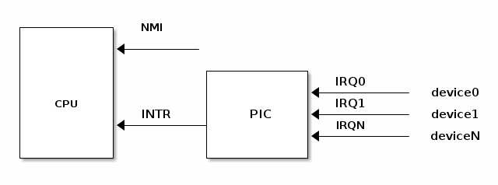
How device raises an interrupt
An irq is an interrupt request line device uses this line to raise an interrupt.
Irq number is a kernel identifier. This is an index value of interrupt vector table.

Slide 5
How device raises an interrupt
device raises an interrupt on the corresponding IRQn pin
PIC will take the IRQ number and writes it to a port for CPU to read
PIC raises an interrupt on CPU INTR pin
PIC waits for CPU to acknowledge an interrupt before raising another interrupt
CPU acknowledges the interrupt then it starts handling the interrupt

Slide 6
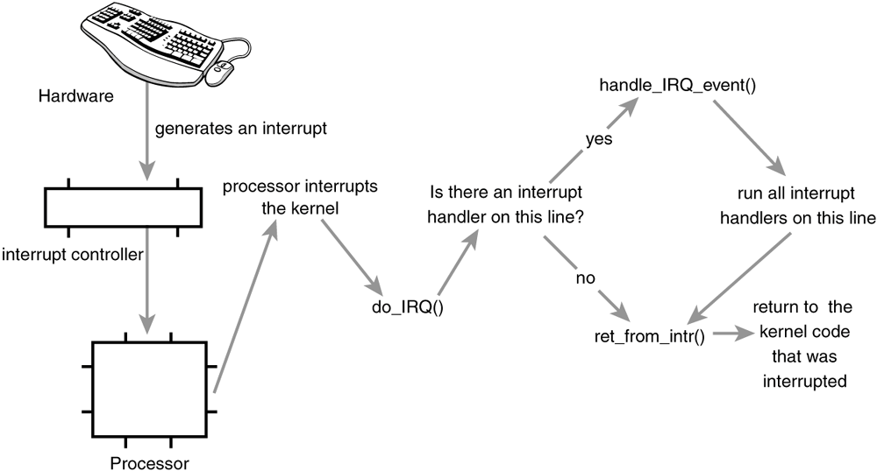

Slide 7
Interrupt Handler
Interrupt handler is a special function, kernel runs in response to specific interrupt.
irqreturn_t intr_handler(int irq, void *dev);
Interrupt handlers return two special values
IRQ_HANDLED
IRQ_NONE

Slide 8
How to register an interrupt handler
int request_irq(unsigned int irq,
irq_handler_t handler,
unsigned long flags,
const char *name,
void *dev);
retrun value:
success – zero
failure -- negative values

Slide 9
Argumets of request_irq()
irq – specifies the interrupt number to allocate.
handler – this is a function pointer to point the actual interrupt handler.
flags –
IRQF_DISABLED - disable all the local interrupts when executing this interrupt handler.
IRQF_SHARED -This flag specifies that the interrupt line can be shared among multiple interrupt handlers.
name – device name, /proc/interrupts will list the irq number and device name.
dev – provide unique cookie to enable or removal of particular interrupt handler from interrupt line.

Slide 10
Freeing an interrupt handler
void free_irq(unsigned int irq,
void * dev);
irq – irq number.
dev – the last parameter of request_irq.

Slide 11
Top/bottom halves
Processing of interrupt is device into two parts.
Top halves
Bottom halves
When Interrupt triggers, Interrupt Handler should be executed very quickly and it should not run for more time. If we have the interrupt handler which is doing more tasks then we need to divide it into two halves.
Top halves
Bottom halves
The top Half is nothing but our interrupt handler. If we want to do less work, then the top half is more than enough. No need for the bottom half in that situation. But if we have more work when interrupt hits, then we need the bottom half. The bottom half runs in the future, at a more convenient time, with all interrupts enabled. So, The job of bottom halves is to perform any interrupt-related work not performed by the interrupt handler.

Slide 12
Why we need bottom halves
Interrupt handlers run with the current interrupt line disabled on all processors.
There are four types of bottom halves mechanisms available.
softirqs
tasklets.
workqueues.
Threaded irq’s

Slide 13
softirqs
Softirqs are statically allocated at the compile time. So we cannot dynamically create or kill the softirqs.
Maximum of 32 softirqs
struct softirq_action -- <linux/interrupt.h>
struct softirq_action
{
void (*action)(struct softirq_action *);
};

Slide 14
Softirqs
We have an array that will maintain registered softirqs in kernel. Whenever you registered softirq from your driver an entry gets created in this array
static struct softirq_action softirq_vec[NR_SOFTIRQS];
NR_SOFTIRQS – this is the last element of enum
There are few softirqs that are already defined. If you create new softirq, we need to recompile the kernel.

Slide 15
Declare softirq
Declare the softirq:
/* PLEASE, avoid to allocate new softirqs, if you need not _really_ high
frequency threaded job scheduling. For almost all the purposes
tasklets are more than enough. F.e. all serial device BHs et
al. should be converted to tasklets, not to softirqs.
*/
enum
{
HI_SOFTIRQ=0,
TIMER_SOFTIRQ,
NET_TX_SOFTIRQ,
NET_RX_SOFTIRQ,
BLOCK_SOFTIRQ,
IRQ_POLL_SOFTIRQ,
TASKLET_SOFTIRQ,
SCHED_SOFTIRQ,
HRTIMER_SOFTIRQ,
RCU_SOFTIRQ, /* Preferable RCU should always be the last softirq */
MY_SOFTIRQ,
NR_SOFTIRQS
};

Slide 16
softirqs
Prototype of softirq handler:
void softirq_handler(struct softirq_handler *)
Registering softirq with the handler”
void open_softirq( int index,
void (*action)(struct softirq_action*) );
index – Softirq entry in enum
action– pointes to the softirq handler

Slide 17
softirqs
Rasising softirq:
void raise_softirq(unsigned int index);
index – Softirq entry .

Slide 18
Tasklets
Taskelets are built on top of softirqs.
Tasklets can be run in parallel, but the same tasklet cannot be run on multiple CPUs at the same time.

Slide 19
tasklets
Tasklets are represented by tasklet_struct structure. It is declared in <linux/interrupt.h>
struct tasklet_struct
{
struct tasklet_struct *next;
unsigned long state;
atomic_t count;
void (*func)(unsigned long);
unsigned long data;
};

Slide 20
tasklets
next – points to the next tasklets in the scheduling queue.
State – state of the tasklet
TASKLET_STATE_SCHED – denotes a tasklet that is scheduled to run.
TASKLET_STATE_RUN -- denotes a tasklet that is running.
count - this will represent whether the tasklet is enabled or disabled.
zero – the tasklet is enabled.
non-zero – the tasklet is disabled.
func – points to the tasklet handler.
data – data to the tasklet handler.

Slide 21
Creating tasklet
Tasklet handler prototype:
Void tasklet_handler(unsigned long data);
We can create tasklet statically or dynamically.
Statically:
DECLARE_TASKLET(name, func, data)
Dynamically:
struct tasklet_struct mytasklet;
tasklet_init(&mytasklet,func,data);

Slide 22
Scheduling tasklets
tasklet_schedule() – schedule the tasklet
tasklet_hi_schedule() – schedule the tasklet with high priority.
tasklet_enable() – enable the tasklet.
tasklet_disable() – disable the tasklet.
Killing the tasklet:
tasklet_kill() – wait for its completion and then kill it

Slide 23
Workqueues
Workqueue are added in the linux kernel 2.6.
If you use workqueue to schedule the work, the scheduled work runs in process context.
Workqueue structure
struct work_struct
{
atomic_long_t data;
struct list_head entry;
work_func_t func;
};

Slide 24
Workqueues
Prototype of workqueue handler:
Void work_handler(struct work_struct *);
Creating work structure in two ways:
Statically
DECLARE_WORK(name, void(*fun)(struct work_struct *));
Dynamically:
struct work_struct mywork;
INIT_WORK(struct work_struct *work, void(*fun)(struct work_struct *));

Slide 25
Scheduling work to the workqueue
schedule_work() – this function puts our work to the default workqueue.
scheduled_delayed_work() – after waiting for a given time this function puts a job in the default workqueue.
schedule_work_on()-- This puts a job on a specific CPU.
scheduled_delayed_work_on()-- After waiting for a given time this puts a job in the default workqueue on the specified CPU.

Slide 26
Threaded irqs
The main goal of threaded IRQs is to reduce the time spent in interrupt handler.
We use request_threaded_irq() instead of request_irq() function.
You do not even have to schedule the bottom half yourself.
The bottom half is then executed in a dedicated kernel thread.

Slide 27
Threaded irqs
int request_threaded_irq(unsigned int irq, irq_handler_t handler,
irq_handler_t thread_fn,
unsigned long irqflags,
const char *devname,
void *dev_id)
thread_fn : thread func, it will call from interrupt handler.
When the handler function returns IRQ_WAKE_THREAD, the kthread associated with this bottom half will be scheduled and thread_fn will be called.

Slide 28
Kernel Api’s
local_irq_disable() - disable local interrupts on the processor.
local_irq_enable() - enable local interrupts on the processor.
local_irq_save() - saves the current state of local interrupts and then disable it.
local_irq_restore() - restore the local interrupts to the gives state.
disable_irq() - disable the gives interrupt line.
enable_irq() - enable the given interrupt line.

Slide 29
Thanks
Any questions ?

